Slide 1
SQL - Basic JOINs
DBMS-1002

Slide 2
In These Slides . . .
We will be covering:
A review of Tables relationships: Keys and ERD basics
JOIN ON Syntax:
Table prefixes (qualifying) and Aliases
Joining multiple tables
INNER vs OUTER JOIN
Alternative JOIN Syntax:
WHERE, NATURAL, USING, and CROSS JOIN

Slide 3
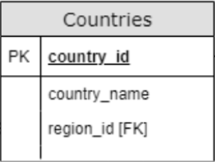
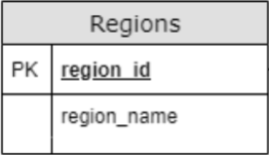
Multiple Tables
We have only ever used SQL to interact with a single table.
However, most meaningful SQL interactions involve the use of 2 or more tables at the same time.
For instance: What if we want to see a Country’s name beside the Region’s name on the same result row?

Slide 4
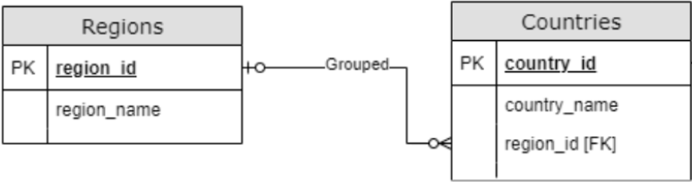
Table Relationships
Let’s review some basic table relationship before we write any SQL.

Slide 5
Table Relationships - ERD
All table relationships will have a line between a Primary Key (PK) and a Foreign Key [FK].
There exists a line between Countries and Regions.
Notice that one end of the line is on: PK region_id
The other line end is on: region_id [FK]

Slide 6
Primary Keys (PK)
Review:
Every table has a Primary Key (PK)
On the Regions table this is: region_id
On the Countries table this is: country_id
Primary Keys must be UNIQUE and must not contain NULL values.
Real world examples:
A Driver’s license, SIN, Student #, etc...

Slide 7
Foreign Keys [FK]
Review:
A Foreign Key [FK] is a column that references the primary key on another table.
The foreign key on the Countries table is: region_id [FK]
Do you remember which table is the Parent and which is the Child?

Slide 8
Parent - Child Table Relationships
Review:
The Child table always contains the Foreign Key [FK].
Regions is the Parent of Countries.
Countries is the Child of Regions.

Slide 9
Table Relationships
region_id region_name
---------- ---------------------
1 Europe
2 Americas
3 Asia
4 Middle East and Africa
id country_name region_id
-- ------------ ---------
AR Argentina 2
AU Australia 3
BE Belgium 1
BR Brazil 2
CA Canada 2
CH Switzerland 1
CN China 3
DE Germany 1
DK Denmark 1
… (more)
Here is sample data from the 2 tables.
Note: The value of the foreign key refers to the value in the primary key!

Slide 10
JOIN ON - Syntax
Now that we have done a quick review of Primary/Foreign keys, let’s use some new syntax to JOIN the two tables together!
We will have two new keywords: JOIN and ON

Slide 11
JOIN ON - Syntax
Generic Syntax Example:
IMPORTANT: We must prefix (or qualify) a table name before a column_name, if the column names are the exact same on both tables. Clarifies which table the column is from.
SELECT tableA.column1, tableA.column2, …
tableB.column1, tableB.column2, …
FROM tableA
JOIN tableB
ON tableA.PrimaryKey=tableB.ForeignKey;

Slide 12
JOIN ON - Syntax
SELECT tableA.column1, tableA.column2, …
tableB.column1, tableB.column2, …
FROM tableA
JOIN tableB
ON tableA.PrimaryKey=tableB.ForeignKey;
The ON keyword is always followed by a boolean expression which resolves to either TRUE or FALSE.
This is used to determine which rows end up in the result set.
IMPORTANT NOTE: the order does not matter, but for consistency you should write the Primary Key on the left side of the equal sign. Primary Key = Foreign Key.

Slide 13
JOIN ON - Syntax
SELECT tableA.column1, tableA.column2, …
tableB.column1, tableB.column2, …
FROM tableA
JOIN tableB
ON tableA.PrimaryKey=tableB.ForeignKey
WHERE …
ORDER BY column_name DESC;
You can use a WHERE and ORDER BY the same way that you always have.

Slide 14
JOIN ON - Example
How do we display the region_name and country_name in the same row? (For now, we will show all columns from all tables using the wildcard character: *)
The primary key and foreign key have the same name: region_id
We have to prefix (qualify) the table names in front because of that.
Note: Regions is the PARENT and therefore is on the LEFT side of the equal sign.
SELECT *
FROM Regions
JOIN Countries
ON regions.region_id=countries.region_id;

Slide 15
JOIN Order of Operations - Example
Regions Table
Countries Table
region_id region_name
---------- ---------------------
1 Europe
2 Americas
3 Asia
id country_name region_id
-- ------------ ---------
AR Argentina 2
BE Belgium 1
CH Switzerland 1
DE Germany 1
ON regions.region_id
= countries.region_id;
When joining these tables, the first row of Regions is compared against the first row of Countries.
If the ON condition resolves to FALSE, move to the next row.
In this case Regions.region_id <> Countries.region_id because:
1 <> 2

Slide 16
JOIN Order of Operations - Example
Regions Table
Countries Table
region_id region_name
---------- ---------------------
1 Europe
2 Americas
3 Asia
id country_name region_id
-- ------------ ---------
AR Argentina 2
BE Belgium 1
CH Switzerland 1
DE Germany 1
ON regions.region_id
= countries.region_id;
If the ON condition is TRUE, then both rows are merged into a single row and added to our result set:
REGION_ID REGION_NAME COUNTRY_ID COUNTRY_NAME REGION_ID
--------- ------------ ---------- -------------- ---------
1 Europe BE Belgium 1

Slide 17
JOIN Order of Operations - Example
Regions Table
Countries Table
region_id region_name
---------- ---------------------
1 Europe
2 Americas
3 Asia
id country_name region_id
-- ------------ ---------
AR Argentina 2
BE Belgium 1
CH Switzerland 1
DE Germany 1
We continue to check each country row for a match until the end of the table, note that duplicate information may occur:
REGION_ID REGION_NAME COUNTRY_ID COUNTRY_NAME REGION_ID
--------- ------------ ---------- -------------- ---------
1 Europe BE Belgium 1
1 Europe CH Switzerland 1
1 Europe DE Germany 1

Slide 18
JOIN Order of Operations - Example
Regions Table
Countries Table
region_id region_name
---------- ---------------------
1 Europe
2 Americas
3 Asia
id country_name region_id
-- ------------ ---------
AR Argentina 2
BE Belgium 1
CH Switzerland 1
DE Germany 1
The pattern repeats and the 2nd row in region is now checked against all rows in the country table:
REGION_ID REGION_NAME COUNTRY_ID COUNTRY_NAME REGION_ID
--------- ------------ ---------- -------------- ---------
1 Europe BE Belgium 1
1 Europe CH Switzerland 1
1 Europe DE Germany 1
2 Americas AR Argentina 2

Slide 19
JOIN Order of Operations - Example
Regions Table
Countries Table
region_id region_name
---------- ---------------------
1 Europe
2 Americas
3 Asia
id country_name region_id
-- ------------ ---------
AR Argentina 2
BE Belgium 1
CH Switzerland 1
DE Germany 1
If a region does not have a match in the countries table, it will NOT be included in the result: Regions.region_id = 3 does not have a matching Countries.region_id that is also 3
REGION_ID REGION_NAME COUNTRY_ID COUNTRY_NAME REGION_ID
--------- ------------ ---------- -------------- ---------
1 Europe BE Belgium 1
1 Europe CH Switzerland 1
1 Europe DE Germany 1
2 Americas AR Argentina 2

Slide 20
JOIN - Prefixing/Qualifying Table Names
Let’s modify our code to prefix (qualify) the columns by their tables:
Note: We must qualify region_id with a table name (because it is the same on both tables). While not required - it is a good practice to qualify every column for consistency.
This does make for A LOT of text though.
SELECT regions.region_id,
regions.region_name,
countries.country_id,
countries.country_name,
countries.region_id
FROM regions
JOIN countries ON regions.region_id = countries.region_id;
Notes:
region_id is the same column name in 2 columns, so it is ambiguous!

Slide 21
JOIN - Table Alias
Using an Alias is a great way to reduce text on your screen:
Notice that we have temporarily RENAMED our tables for this query:
Regions to the letter r
Countries to the letter c
Your alias name may be longer for clarity, but you’ll often see short names to reduce text.
SELECT r.region_id, r.region_name,
c.country_id, c.country_name, c.region_id
FROM regions r
JOIN countries c ON r.region_id = c.region_id;
Notes:
The SQL here is the same as in the last slide. Also, yes, the declaration of the new alias name appears AFTER it is already used by columns, this may seem strange at first if you already have programming experience.

Slide 22
JOIN - INNER JOIN
There are several kinds of JOINs in SQL.
The default JOIN we performed is called an INNER JOIN.
The keyword INNER in the above code is not necessary (but it will also work if you include it).
Typically it is not included
SELECT r.region_id, r.region_name,
c.country_id, c.country_name, c.region_id
FROM regions r
INNER JOIN countries c
ON r.region_id = c.region_id;

Slide 23
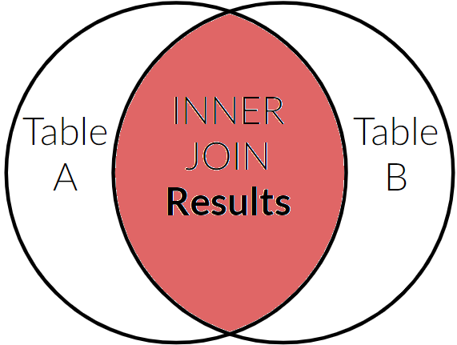
JOIN - INNER JOIN
The INNER JOIN will only show results where a match is made between two tables.
TableA is Regions.
TableB is Countries.
Results INCLUDE: Regions that have Countries
Countries that have Regions
EXCLUDED from results:
Regions with no Countries
Countries not assigned to a Region!

Slide 24
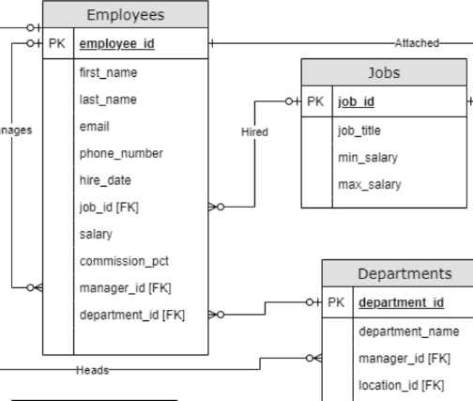
JOIN - INNER JOIN - Practice
TRY IT!
Show each employee’s last name and their current job title.
TRY IT … #2!
Show each employee’s first name and their current department name.
TRY IT … CHALLENGE!
Show all employees full names alongside their manager’s full name. (HINT: You need the Employees table twice)

Slide 25
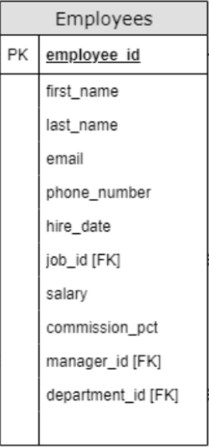
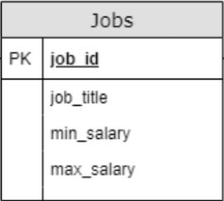
JOIN - INNER JOIN - Practice
TRY IT! - SOLUTION:
An Employee can have one Job...
The Primary Key of Jobs is: job_id
Employees has a Foreign Key: job_id [FK]

Slide 26
JOIN - INNER JOIN - Practice
TRY IT! - SOLUTION:
Show each employee’s last name and their current job title.
Remember: Primary key should be on the left
SELECT e.last_name, j.job_title
FROM jobs j
JOIN employees e ON j.job_id = e.job_id;

Slide 27
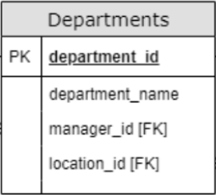
JOIN - INNER JOIN - Practice
TRY IT … #2! - SOLUTION:
An Employee can have one department…
The Departments PK is: department_id
The Employee’s FK is: department_id [FK]

Slide 28
JOIN - INNER JOIN - Practice
TRY IT … #2! - SOLUTION:
Show each employee’s first name and their current department name.
Note: The Primary key is on the LEFT side of the equal sign.
SELECT e.first_name, d.department_name
FROM employees e
JOIN departments d
ON d.department_id = e.department_id;

Slide 29
JOIN - Self JOIN
TRY IT … CHALLENGE! - SOLUTION:
An Employee can have one manager, who is also an Employee...
The Primary Key of Employee is: employee_id
Employees has a Foreign Key: manager_id [FK]
This is called a CIRCULAR or RECURSIVE reference!
The table refers to itself, so this is a self-join.

Slide 30
JOIN - Self JOIN
TRY IT … CHALLENGE! - SOLUTION:
An Employee can have many managers, who are also an Employee...
What would make this query easy to code?
Suppose the Employees table were split into two separate tables that looked like this:
Managers

Slide 31
JOIN - Self JOIN
Managers
TRY IT … CHALLENGE! - SOLUTION:
I want to list the name of all Employees and their managers name
SELECT e.first_name AS "Employee First Name",
e.last_name AS "Employee Last Name",
m.first_name AS "Manager First Name",
m.last_name AS "Manager Last Name"
FROM employees e
JOIN Managers m ON m.employee_id = e.manager_id;

Slide 32
JOIN - Self JOIN - Practice
TRY IT … CHALLENGE! - SOLUTION:
Show all employees full names alongside their manager’s full name.
Well, this almost works, only we have one Employees table, not an Employees and Managers tables!
ANSWER: Use an alias
The columns were renamed above for clarity.
SELECT e.first_name AS "Employee First Name",
e.last_name AS "Employee Last Name",
m.first_name AS "Manager First Name",
m.last_name AS "Manager Last Name"
FROM employees e
JOIN employees m ON m.employee_id = e.manager_id;

Slide 33
JOIN - Multiple Tables
What if we want to JOIN 3 or more tables?
For Example:
Show the full name of all Employees, their job title and their department name.

Slide 34
JOIN - Multiple Tables - Practice
Show the full name of all Employees, their job title and their department name.
Could we have ordered the tables differently?
Yes! As long as there is a way to connect a Primary Key with a Foreign key, the table ordering will not matter in this case.
SELECT e.first_name, e.last_name,
j.job_title, d.department_name
FROM employees e
JOIN departments d
ON d.department_id = e.department_id
JOIN jobs j ON j.job_id = e.job_id;

Slide 35
JOIN - Multiple Tables - Practice
Alternative table orderings: Note the different order of the tables
SELECT e.first_name, e.last_name,
j.job_title, d.department_name
FROM departments d
JOIN employees e ON d.department_id = e.department_id
JOIN jobs j ON j.job_id = e.job_id;
SELECT e.first_name, e.last_name,
j.job_title, d.department_name
FROM jobs j
JOIN employees e ON j.job_id = e.job_id
JOIN departments d
ON d.department_id = e.department_id;

Slide 36
Summary
We covered:
A review of Tables relationships:
Keys and ERD basics
INNER JOIN ON Syntax:
Table prefixes (qualifying) and Aliases
Self-Joins
Joining multiple tables

Slide 37
Up Next . . .
We will be covering:
The OUTER JOINs: LEFT, RIGHT, FULL
Alternative JOIN Syntax:
WHERE JOIN,
NATURAL,
USING,
CROSS JOIN

